Slide 1
Software Systems as Cities: A Controlled Experiment
Richard Wettel, Michele Lanza, and Romain Robbes
Published in 33rd International Conference on Software Engineering, 2011
Presented by Erik Shreve

Slide 2
Software Cities
Definition: A software visualization technique wherein aspects of software are modeled on a city metaphor.
Tool developed by Wettel et al. in 2008
Several published papers, and the tool is available for free as an Eclipse plugin for non-commercial use.
Author’s Website (has three papers on CodeCity and the Technical Report detailing the experiments)
http://wettel.github.io/

Slide 3
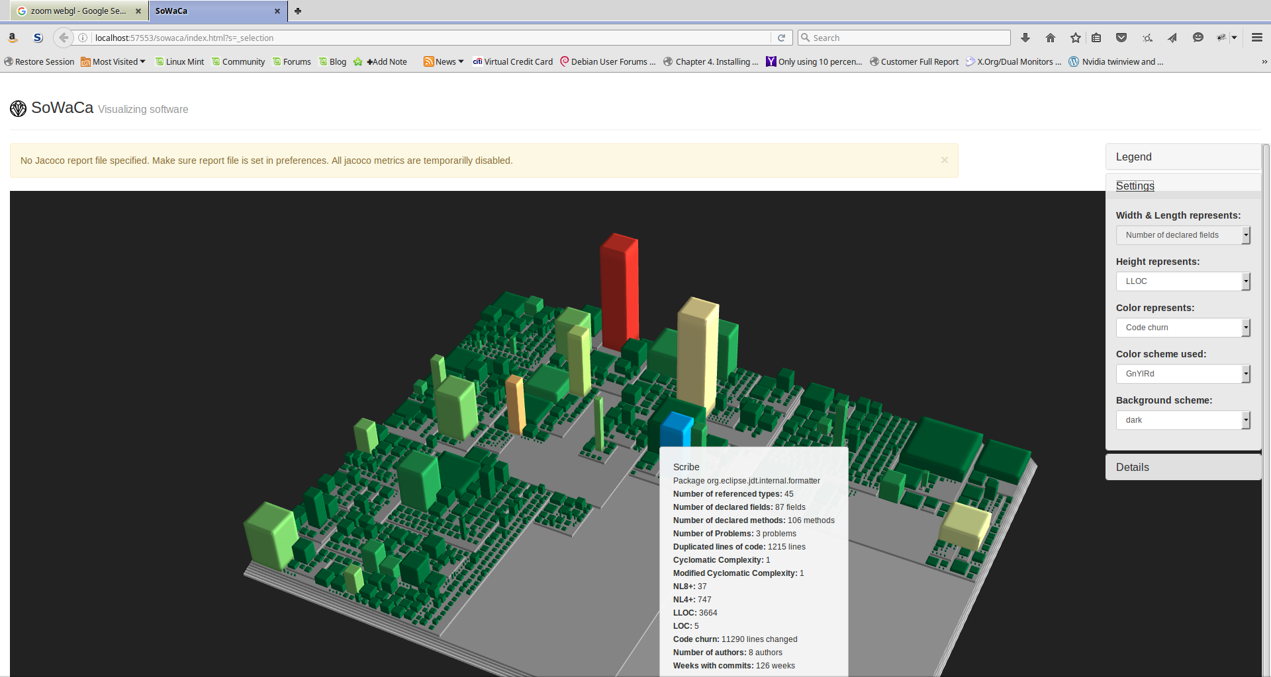
A still picture is worth a 1000 words

Slide 4
A live demo is worth more…

Slide 5
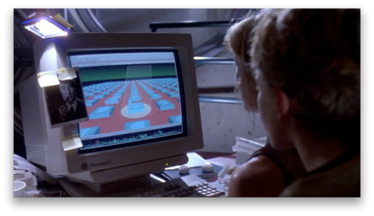
I’ve seen this before…
It’s a UNIX system!
I know this…

Slide 6
Tool Evaluation
The paper published in 2011 presents results as to the usefulness of the tool.
CodeCity was compared to the use of Eclipse with Excel (yes, the spreadsheet software).
With two toolsets (Eclipse + Excel, and CodeCity) and two Java Systems, a total of four treatments were available for experimentation.

Slide 7
Evaluated Tasks
ID | Description | Concern/Rationale
A1 | Locate all unit test classes AND ID the convention used to organize the tests | Structural understanding. Developers need to know where to add tests.
A2.1 A2.2 | Look for the term T1/T2 in class, attribute, and method names. Describe the spread of these classes (localized vs dispersed). T1/T2 chosen to have different spread. | Concept location for developer understanding and for maintenance.
A3 | Evaluate the change impact of class C considering caller classes. | Impact Analysis
A4.1 | Find the three classes with the highest number of methods. | Metric-based analysis. Aids prioritization of refactoring.
A4.2 | Find the three classes with the highest avg. LOC per method. | Metric-based analysis. Aids prioritization of refactoring.
Notes:
Do a quick vote on which ones ppl think will be aided by the tool

Slide 8
Evaluated Tasks
ID | Description | Concern/Rationale
A1 | Locate all unit test classes AND ID the convention used to organize the tests | Structural understanding. Developers need to know where to add tests.
A2.1 A2.2 | Look for the term T1/T2 in class, attribute, and method names. Describe the spread of these classes (localized vs dispersed). T1/T2 chosen to have different spread. | Concept location for developer understanding and for maintenance.
A3 | Evaluate the change impact of class C considering caller classes. | Impact Analysis
A4.1 | Find the three classes with the highest number of methods. | Metric-based analysis. Aids prioritization of refactoring.
A4.2 | Find the three classes with the highest avg. LOC per method. | Metric-based analysis. Aids prioritization of refactoring.
Eclipse
Excel

Slide 9
Evaluated Tasks
ID | Description | Concern/Rationale
B1.1 B1.2 | Identify the package with highest percentage of god classes in the system. Identify the god class containing the highest number of methods. | Focused design assessment. God classes know too much. Large size & complexity makes maintenance hard.
B2.1 B2.2 | Identify the dominant (impacts highest number of classes) class-level design problem. Write an overview of your findings, citing interesting and/or unexpected observations. | Holistic design assessment.

Slide 10
Experiments – Objects & Participants
Two Java systems were analyzed.
FindBugs - 93 KLOC, 1320 classes, ~120 classes with design-level problems identified
Azeureus – 450 KLOC, 4,656 classes, ~425 classes with design-level problems identified
Seven experiments run. Five had at least eight participants. One experiment had five, and one experiment had only a single participant.
Participants included professionals with 4-20 years of experience, practitioner with over 10 years experience, Ph.D and MSc students, a professor (?), and 2 consultants (?).
What’s the difference between a consultant, a practitioner , and a professional? Not explained.

Slide 11
Results
ID | Description | Result Correctness | Result Time
A1 | Locate all unit test classes AND ID the convention used to organize the tests | Mixed. Code City better for med. sys. | Code City better
A2.1 A2.2 | Look for the term T1/T2 in class, attribute, and method names. Describe the spread of these classes (localized vs dispersed). T1/T2 chosen to have different spread. | Code City better | Code City better
A3 | Evaluate the change impact of class C considering caller classes. | Code City much better | Code City better
A4.1 | Find the three classes with the highest number of methods. | Mixed. Code City better on large sys. | Excel better
A4.2 | Find the three classes with the highest avg. LOC per method. | Invalidated. Only expert could finish using CodeCity. | Invalidated
Notes:
Note that for 4.2, Excel users were able to complete the task. Furthermore, given the results for A4.1, I expect Excel would have been better.

Slide 12
Results
ID | Description | Result Correctness | Result Time
B1.1 B1.2 | Identify the package with highest percentage of god classes in the system. Identify the god class containing the highest number of methods. | Mixed. CodeCity better on large sys. CodeCity Better | CodeCity Better CodeCity Better
B2.1 B2.2 | Identify the dominant (impacts highest number of classes) class-level design problem. Write an overview of your findings, citing interesting and/or unexpected observations. | CodeCity Better CodeCity Better | CodeCity Better CodeCity Better

Slide 13
Result Summary
On average:
Code City ~12% faster across tasks
Limit of 10 minutes provided for each task.
Average task time for Excel/Eclipse was ~4.5 minutes
Average time savings was ~32 seconds per task.
Code City leads to ~25% more accurate conclusions by participants.

Slide 14
Threats to Validity
All the participants were men
Research suggests that women see more color gradations that men
Research suggests that men tend to have better visual-spatial skills than women
Experimental Environmental issues
One experiment held at an eXtreme Programming group meeting and resulted in “spectators” working with “a couple of the” participants. This experiment was heavily weighted toward CodeCity use. 6 out of the 22 sets of task evaluations for CodeCity were from this experiment.

Slide 15
Conclusion
CodeCity is a source code visualization tool that is:
Available for use today!
Can help developers gain high level understanding of a code base for assistance in collecting data used for maintenance decisions (refactoring, bug fixing, etc…)
Usability studies are hard

Slide 16
Discussion Questions
Do you find the tool interesting? Why?
What additional visual information could be added to such a view? (Today it is only presenting a set of colored rectangular prisms.)
Notes:
Pragmatic Programmer by Andy Hunt and Dave Thomas talks about “No broken windows”

Slide 17
What do you think of the evaluated tasks? Do you consider any of them unimportant? Would you have added tasks?
ID | Description
A1 | Locate all unit test classes AND ID the convention used to organize the tests
A2.1 A2.2 | Look for the term T1/T2 in class, attribute, and method names. Describe the spread of these classes (localized vs dispersed). T1/T2 chosen to have different spread.
A3 | Evaluate the change impact of class C considering caller classes.
A4.1 | Find the three classes with the highest number of methods.
A4.2 | Find the three classes with the highest avg. LOC per method.
B1.1 B1.2 | Identify the package with highest percentage of god classes in the system. Identify the god class containing the highest number of methods.
B2.1 B2.2 | Identify the dominant (impacts highest number of classes) class-level design problem. Write an overview of your findings, citing interesting and/or unexpected observations.
Notes:
Note that for 4.2, Excel users were able to complete the task.

Slide 18
Backup Slides

Slide 19
Links
Author’s Website (has three papers on CodeCity and the Technical Report detailing the experiments)
http://wettel.github.io/

